Slide 1

Scrum Master

Slide 2
Course Objectives
To enable delegates to:
Understand the Scrum Framework.
Understand how a product can be developed using Scrum.
The art of being a Scrum Master.
Notes:
Suggestion* Talk about there being no one text book for Scrum, that you don’t become a Scrum Master by sitting a course or reading a book but by doing the job
Suggestion* Discuss how psychology and an understanding of people is a big part of the SM role, as much as understanding Scrum itself.

Slide 3

Agenda
What is Agile?
The need for Agile
Definition of Scrum
Scrum Values
Scrum Theory
Scrum Roles
Scrum Events & Artifacts
Scaling Scrum

Slide 4
What is Agile
Agile Software Development is an umbrella term for a set of methods and practices based on the values and principles expressed in the Agile Manifesto.
Solutions evolve through collaboration between self-organizing, cross-functional teams utilizing the appropriate practices for their context.
Source: agilealliance.org
Notes:
Suggestion* I introduce what is driving agile, from companies like Google through to government bodies…Scrum has been proven to work even on government projects where the need for governance may be higher, which is why the British government has been pushing agile ways of working.
Sentinel project (virtual case file, 2000-2005, 170mio., Total 575mio.):
Original budget 451mio., 400 to 40 staff, 1 year, 30mio.
http://www.scrumcasestudies.com/fbi/
http://www.informationweek.com/applications/fbis-sentinel-project-5-lessons-learned/d/d-id/1105637?

Slide 5

The Agile Manifesto
We are uncovering better ways of developing software by doing it and helping others do it. Through this work we have come to value:
Individuals and Interactions | over | Processes and Tools
Working Software | over | Comprehensive Documentation
Customer Collaboration | over | Contract Negotiation
Responding to Change | over | Following a Plan
That is; while there is value in the items on the right;
we value the items on the left more.
Notes:
In February 2001, 17 software developers met at the Snowbird, Utah, resort, to discuss lightweight development methods. They published the Manifesto for Agile Software Development to define the approach now known as agile software development. Some of the manifesto's authors formed the Agile Alliance, a non-profit organization that promotes software development according to the manifesto's principles.
While Agile is seen to be at the left hand side of this manifesto, and Waterfall (sequential/traditional) is to the right hand side, exactly how far left varies from method to method. XP (extreme programming) is seen as way left (gung ho) whereas DSDM can be seen as to be further right (cautious) than other methods. Scrum is probably left of centre.
USA 2001 - Representatives of all the leading “agile” methods got together and created the manifesto for the newly formed Agile Alliance over a 2 day period.
Arie van Bennekim – [DSDM]
Kent Beck; Ron Jeffries; Ward Cunningham; Bob Martin; Martin Fowler; James Grenning – [XP]
Ken Schwaber; Mike Beedle; Jeff Sutherland – [Scrum]
Alistair Cockburn – [Crystal]
Jim Highsmith – [ASD (Adaptive Software Development)]
Brian Marick; Andy Hunt; Dave Thomas – [no specific allegiance]
Steve Mellor and John Kern – [Modelling tools]
Some Agile methods e.g. XP are way over to the left hand side of the manifesto statements (extremely flexibility, no basic foundations defined), others are seen as more “middle of the road” e.g. DSDM
The meanings of the manifesto items on the left are:
Individuals and interactions: self-organization and motivation are important, as are interactions like co-location and pair programming.
Working software: working software is more useful and welcome than just presenting documents to clients in meetings.
Customer collaboration: requirements cannot be fully collected at the beginning of the software development cycle, therefore continuous customer or stakeholder involvement is very important.
Responding to change: agile methods are focused on quick responses to change and continuous development.

Slide 6
Agile frameworks
Many frameworks are recognised as being agile
Some are more common than others
Some are only applicable to IT
Scrum, Kanban,
Lean, DSDM/AgilePM
XP, SAFe, DAD,
Lean Startup,
DevOps,
FDD, Crystal, ASD
Notes:
General knowledge and background around agile.
Kanban: https://en.wikipedia.org/wiki/Kanban
Lean: https://en.wikipedia.org/wiki/Lean_manufacturing
DSDM: https://www.dsdm.org/resources/dsdm-handbooks/the-dsdm-agile-project-framework-2014-onwards
XP: http://www.extremeprogramming.org/
SAFe: http://www.scaledagileframework.com/
DAD: http://www.disciplinedagiledelivery.com/
Lean Startup: http://theleanstartup.com/
DevOps: https://en.wikipedia.org/wiki/DevOps
FDD: http://www.agilemodeling.com/essays/fdd.htm
Crystal: https://en.wikiversity.org/wiki/Crystal_Methods
ASD: https://en.wikipedia.org/wiki/Adaptive_software_development

Slide 7
The need for Agile
“The ‘relay race’ approach to product development may conflict with the goals of maximum speed and flexibility.
Instead a holistic or ‘rugby’ approach —where a team tries to go the distance as a unit, passing the ball back and forth —may better serve today’s competitive requirements.”
Hirotaka Takeuchi and Ikujiro Nonaka,
“The New New Product Development Game”, Harvard Business Review, January 1986.
Notes:
Mr. Takeuchi is an associate professor and Mr. Nonaka, a professor at Hitotsubashi University in Japan. Mr. Takeuchi's research has focused on marketing and global competition. Mr. Nonaka has published widely in Japan on organizations, strategy, and marketing.
The New New Product Development Game is a study of how some organisations have managed to speed up the process of developing new products.
It’s rugby analogy allegedly led Ken Schwaber to choose the name Scrum. The story is that Ken didn’t know much about rugby and assumed a rugby scrum was akin to a huddle in American football.

Slide 8
Waterfall Model
Requirements
Design
Code
Test
Live
FIXED GO LIVE DATE!
Notes:
Suggestion * Discuss how in waterfall models how if you have to go live a lot of testing gets pushed into the live environment.
Suggested exercise (see exercise folder)* Jenga Testing (run through round 1 to show how Waterfall testing works)
Slide builds to push testing past the go live date. Discuss about value delivered at the end instead of incrementally.
Source: https://en.wikipedia.org/wiki/Waterfall_model
In Royce's original waterfall model, the following phases are followed in order:
1.System and software requirements: captured in a product requirements document
2.Analysis: resulting in models, schema, and business rules
3.Design: resulting in the software architecture
4.Coding: the development, proving, and integration of software
5.Testing: the systematic discovery and debugging of defects
6.Operations: the installation, migration, support, and maintenance of complete systems
Thus the waterfall model maintains that one should move to a phase only when its preceding phase is reviewed and verified.
Various modified waterfall models (including Royce's final model), however, can include slight or major variations on this process.[3] These variations included returning to the previous cycle after flaws were found downstream, or returning all the way to the design phase if downstream phases deemed insufficient.

Slide 9


Sequential vs. overlapping development
Requirements
Design
Code
Test
Rather than doing all of one thing at a time...
...Scrum teams do a little of everything all the time.
Source: “The New New Product Development Game” by Takeuchi and Nonaka. Harvard Business Review, January 1986.
Notes:
This is the essence of Agile. Take a portion of the product; understand the requirements for just that portion in detail while designing, coding and testing at the same time as gathering this detail.
Suggested exercise (see exercise folder)* Jenga Testing (run through round 2 and 3 to show how agile testing works)
Round two is to show testing if it’s a separate team testing, but testing is being built in. Round three is to explain how testing works if the testers are integrated.

Slide 10


Scrum
Notes:
Introduction slide.
Suggestion* Introduce the Scrum guide at the back of the materials and explain that all of our discussions will be aligned with this guide.
The guide doesn’t provide the detail of how we go about these events, how we build our artefacts…that will be the focus of our discussions.

Slide 11
Definition of Scrum
Scrum (n): A framework within which people can address complex adaptive problems, while productively and creatively delivering products of the highest possible value.
Scrum is:
Lightweight
Simple to understand
Difficult to master
Notes:
Scrum is a process framework that has been used to manage complex product development since the early 1990s. Scrum is not a process or a technique for building products; rather, it is a framework within which you can employ various processes and techniques. Scrum makes clear the relative efficacy of your product management and development practices so that you can improve.
The Scrum framework consists of Scrum Teams and their associated roles, events, artefacts, and rules. Each component within the framework serves a specific purpose and is essential to Scrum’s success and usage.
The rules of Scrum bind together the events, roles, and artefacts, governing the relationships and interaction between them.
Specific tactics for using the Scrum framework vary and are described elsewhere.
Scrum is NOT about Project Management, but can be used for Project delivery.
No person or organisation ‘owns’ Scrum.
There is no definitive text book that defines Scrum.

Slide 12
Scrum in the Product Lifecycle
Product conceived, developed and launched.
Product goes ‘end of life’, is removed from use.
Product on sale / in live use.
Development Project
SCRUM
Enhancement Project
Enhancement Project
Termination
Product Lifecycle
Support and Maintenance
Notes:
*Suggested discussion – even though Scrum is not used for project management, it can be used for product delivery in a Project. Discuss Scrum in this context and then as product development on its own and use in BAU environments.
This slide is used to illustrate that:
- Scrum is NOT project management
- It can be used for software maintenance as well as software development
- It is product focussed NOT project focussed
- Therefore it can be used during projects but does not have to stop at the end of a project

Slide 13

Scrum Values
Notes:
Suggestion* Start a discussion on why these values are so important, do the delegates see these values being applied in their own environments?
Scrum values
All work performed in Scrum needs a firm foundation of values for the team's process and principles. With its emphasis on teamwork and continuous improvement, Scrum both creates those values and relies on them. The values are focus, courage, openness, commitment, and respect. From the team's perspective, the values offer the following guides: Focus. Because we focus on only a few things at a time, we work well together and produce excellent work. We deliver valuable items sooner.
Courage. Because we are not alone, we feel supported and have more resources at our disposal. This gives us the courage to undertake greater challenges.
Openness. As we work together, we practice expressing how we're doing and what's in our way. We learn that it is good to express concerns so that they can be addressed.
Commitment. Because we have great control over our own destiny, we become more committed to success.
Respect. As we work together, sharing successes and failures, we come to respect each other and to help each other become worthy of respect.
If an organization will let Scrum do its work, everyone involved will discover the benefits and will begin to understand why Scrum both engenders and relies upon these values.

Slide 14

Scrum Theory
Adaption
Transparency
1
3
Inspection
2
Notes:
Empirical process control theory:
Experience=>Knowledge=>Making Decisions
Scrum employs an iterative, incremental approach to optimize predictability and control risk.

Slide 15

Transparency
Significant aspects of the process that affect the outcome must be visible to everybody involved.
1
Notes:
Transparency
Significant aspects of the process must be visible to those responsible for the outcome. Transparency requires those aspects be defined by a common standard so observers share a common understanding of what is being seen.
For example:
• A common language referring to the process must be shared by all participants; and,
• Those performing the work and those accepting the work product must share a common definition of “Done”.
Definition of “Done”:
Any one product or system should have a definition of “Done” that is a standard for any work done on it.
If there are multiple Scrum Teams working on the system or product release, the development teams on all of the Scrum Teams must mutually define the definition of “Done.”

Slide 16

1
Inspection
Scrum users must frequently inspect Scrum artifacts and progress toward a Sprint Goal to detect undesirable variances.
2
Notes:
Inspection
Scrum users must frequently inspect Scrum artefacts and progress toward a Sprint Goal to detect undesirable variances. Their inspection should not be so frequent that inspection gets in the way of the work. Inspections are most beneficial when diligently performed by skilled inspectors at the point of work.

Slide 17

1
Adaptation
3
If an inspector
determines that one or more aspects of a process deviate outside acceptable limits, and that the resulting product will be unacceptable, the process or the material being processed must be adjusted.
Notes:
Adaptation
An adjustment must be made as soon as possible to minimize further deviation.

Slide 18
Project noise level
Empirical processes work well here
Far from
Agreement
Anarchy
Defined processes work well here
Complex
Requirements
Complicated
And here
Close to
Agreement
Simple
Close to
Certainty
Technology
Far from
Certainty
Source: Strategic Management and Organizational Dynamics by Ralph Stacey in Agile Software Development with Scrum by Ken Schwaber and Mike Beedle.
Notes:
Where there is uncertainty in requirements and uncertainty in technology, i.e. in very many software development projects, the development becomes increasingly complex. Waterfall does not cope well with the noise that comes with complexity. Agile does.
Suggestion* Discuss frameworks and tools for looking at complexity and risks associated with the work, these can help select the right framework…I always mention that if this isn’t the right way to work for your organization or the piece of work you are doing then don’t use it.
Cynefin Framework: https://en.wikipedia.org/wiki/Cynefin_Framework
Agile-o-meter: https://www.scrumalliance.org/community/articles/2014/march/the-agile-o-meter
PAQ: https://www.dsdm.org/content/appendix-b-project-approach-questionnaire-paq-0

Slide 19

Scrum Events
Sprint Planning
Daily Scrum
Sprint Review
Sprint Retrospective
Notes:
Scrum prescribes four formal events for inspection and adaptation, as described in the Scrum Events section of the Scrum Guide:
• Sprint Planning
• Daily Scrum
• Sprint Review
• Sprint Retrospective
Discuss the events in this context.
These will be discussed in detail later

Slide 20
The Scrum Team
Notes:
Suggestion** Introduce the chickens and pigs story…understand stakeholder involvement but the team are the pigs.
Reference: https://en.wikipedia.org/wiki/The_Chicken_and_the_Pig
The fable of the Chicken and the Pig is used to illustrate the differing levels of project stakeholders involved in a project. The basic fable runs:^{[1]}
A Pig and a Chicken are walking down the road. The Chicken says: "Hey Pig, I was thinking we should open a restaurant! "Pig replies: "Hm, maybe, what would we call it? "The Chicken responds: "How about 'ham-n-eggs'? "The Pig thinks for a moment and says: "No thanks. I'd be committed, but you'd only be involved."
The Scrum Team
The Scrum Team consists of a Product Owner, the Development Team, and a Scrum Master. Scrum Teams are self-organizing and cross-functional. Self-organizing teams choose how best to accomplish their work, rather than being directed by others outside the team. Cross-functional teams have all competencies needed to accomplish the work without depending on others not part of the team. The team model in Scrum is designed to optimize flexibility, creativity, and productivity.
Scrum Teams deliver products iteratively and incrementally, maximizing opportunities for feedback. Incremental deliveries of “Done” product ensure a potentially useful version of working product is always available.
Key points
Cross-functional
All skills needed to accomplish the work
Minimise dependencies outside the team
Self-organising
Choose how to accomplish their work
Not directed by others outside the team

Slide 21
The Product Owner
Creates and communicates the Product Vision.
Clearly expressing Product Backlog items.
Ordering the items in the Product Backlog.
Optimizing the value of the work.
Ensuring that the Product Backlog is visible, transparent and clear to all.
Ensuring the Development Team understands items in the Product Backlog to the level needed.
360⁰ voice.
Notes:
Suggestions for discussion**
Discuss all of the stakeholder engagement the Product Owner would need to do to define the Product Backlog, the fact they would need to secure funding so would probably be defining a business case etc… none of this is a part of the Scrum Guide.
How does the Product Owner drive product success?
What is a Product Vision?
How does your PO communicate the vision? Do you have a roadmap? Are the Product goals SMART? Are they communicated?
Discuss the work the PO is doing before to define the initial backlog.
Discuss stakeholder workshops.
The Product Owner
The Product Owner is responsible for maximizing the value of the product and the work of the Development Team. How this is done may vary widely across organizations, Scrum Teams, and individuals.
The Product Owner is the sole person responsible for managing the Product Backlog. Product Backlog management includes:
• Clearly expressing Product Backlog items;
• Ordering the items in the Product Backlog to best achieve goals and missions;
• Optimizing the value of the work the Development Team performs;
• Ensuring that the Product Backlog is visible, transparent, and clear to all, and shows what the Scrum Team will work on next; and,
• Ensuring the Development Team understands items in the Product Backlog to the level needed.
The Product Owner may do the above work, or have the Development Team do it. However, the Product Owner remains accountable.
The Product Owner is one person, not a committee. The Product Owner may represent the desires of a committee in the Product Backlog, but those wanting to change a Product Backlog item’s priority must address the Product Owner.
For the Product Owner to succeed, the entire organization must respect his or her decisions. The Product Owner’s decisions are visible in the content and ordering of the Product Backlog.
No one is allowed to tell the Development Team to work from a different set of requirements, and the Development Team isn’t allowed to act on what anyone else says.

Slide 22

The Product Backlog
The Product Backlog lists all features, functions, requirements, enhancements, and fixes that constitute the changes to be made to the product in future releases.
Product Backlog items have the attributes of a description, order, estimate and value.
Notes:
**Suggestion
Continue the discussion about vison, roadmap, epics, personas and user stories.
Introduce INVEST. http://xp123.com/articles/invest-in-good-stories-and-smart-tasks/
**Suggested exercise
User Stories Previous SM folder – use the coach surfing scenario and get the delegates to write personas and then user stories for those personas.
The Scrum Master may have to guide an inexperienced PO in how to carry out this work, so the SM needs an understanding even if it is a PO responsibility.
Product Backlog (Intro, refinement discussed later)
The Product Backlog is an ordered list of everything that might be needed in the product and is the single source of requirements for any changes to be made to the product. The Product Owner is responsible for the Product Backlog, including its content, availability, and ordering.
A Product Backlog is never complete. The earliest development of it only lays out the initially known and best-understood requirements. The Product Backlog evolves as the product and the environment in which it will be used evolves. The Product Backlog is dynamic; it constantly changes to identify what the product needs to be appropriate, competitive, and useful. As long as a product exists, its Product Backlog also exists.
The Product Backlog lists all features, functions, requirements, enhancements, and fixes that constitute the changes to be made to the product in future releases. Product Backlog items have the attributes of a description, order, estimate and value.
As a product is used and gains value, and the marketplace provides feedback, the Product Backlog becomes a larger and more exhaustive list. Requirements never stop changing, so a Product Backlog is a living artefact. Changes in business requirements, market conditions, or technology may cause changes in the Product Backlog.
Multiple Scrum Teams often work together on the same product. One Product Backlog is used to describe the upcoming work on the product. A Product Backlog attribute that groups items may then be employed.

Slide 23
The Development Team
Self-organizing
Stable
Cross-functional
No titles
No sub-teams
3 – 9 team members
Notes:
Suggestions**
Good article on self-organising teams: https://appdevelopermagazine.com/3824/2016/4/11/About-Self-Organizing-Teams/
How do your teams deal with or how do you think your teams will deal with the concept of whole team accountability? Discuss a no blame culture.
Do your teams create and maintain the sprint backlog or are they being directed as to what they will work on?
How does the team deal with progress tracking in your environment?
What level of authority does the team have?
Discuss the importance of team stability – Tuckmans model : http://www.businessballs.com/tuckmanformingstormingnormingperforming.htm
Suggested exercise: Exercises folder – Multi-tasking
The Development Team
The Development Team consists of professionals who do the work of delivering a potentially releasable Increment of “Done” product at the end of each Sprint. Only members of the Development Team create the Increment.
Development Teams are structured and empowered by the organization to organize and manage their own work. The resulting synergy optimizes the Development Team’s overall efficiency and effectiveness.
Development Teams have the following characteristics:
• They are self-organizing. No one (not even the Scrum Master) tells the Development Team how to turn Product Backlog into Increments of potentially releasable functionality;
• Development Teams are cross-functional, with all of the skills as a team necessary to create a product Increment;
• Scrum recognizes no titles for Development Team members other than Developer, regardless of the work being performed by the person; there are no exceptions to this rule;
• Scrum recognizes no sub-teams in the Development Team, regardless of particular domains that need to be addressed like testing or business analysis; there are no exceptions to this rule; and,
• Individual Development Team members may have specialized skills and areas of focus, but accountability belongs to the Development Team as a whole.

Slide 24

The Scrum Master
The Scrum Master is responsible for ensuring Scrum is understood and enacted.
Scrum Masters do this by ensuring that the Scrum Team adheres to Scrum theory, practices, and rules.
Is that all the Scrum Master does?
Notes:
Suggestion** exercises folder – Scrum Master Checklist you could take the delegates through an example checklist for Scrum Masters, which would help identify the amount of things a SM must focus on day to day.
The Scrum Master
The Scrum Master is responsible for ensuring Scrum is understood and enacted. Scrum Masters do this by ensuring that the Scrum Team adheres to Scrum theory, practices, and rules.
The Scrum Master is a servant-leader for the Scrum Team. The Scrum Master helps those outside the Scrum Team understand which of their interactions with the Scrum Team are helpful and which aren’t. The Scrum Master helps everyone change these interactions to maximize the value created by the Scrum Team.

Slide 25
The Servant Leader
Listening
The servant-leader shares power, puts the needs of others first and helps people develop and perform as highly as possible.
Growth of
people
Empathy
Stewardship
Awareness
Persuasion
Source: www.greenleaf.org
Notes:
Suggested ** http://blog.scrum.org/the-scrum-master-as-a-servant-leader/
Listening Leaders have traditionally been valued for their communication and decision making skills. Although these are also important skills for the servant leader, they need to be reinforced by a deep commitment to listening intently to others. The servant leader seeks to identify the will of a group and helps to clarify that will. He or she listens receptively to what is being said and unsaid. Listening also encompasses hearing one’s own inner voice. Listening, coupled with periods of reflection, is essential to the growth and well-being of the servant leader.
Empathy The servant leader strives to understand and empathize with others. People need to be accepted and recognized for their special and unique spirits. One assumes the good intentions of co-workers and colleagues and does not reject them as people, even when one may be forced to refuse to accept certain behaviors or performance. The most successful servant leaders are those who have become skilled empathetic listeners.
Awareness General awareness, and especially self-awareness, strengthens the servant-leader. Awareness helps one in understanding issues involving ethics, power, and values. It lends itself to being able to view most situations from a more integrated, holistic position. As Greenleaf (1977/2002) observed: “Awareness is not a giver of solace—it is just the opposite. It is a disturber and an awakener. Able leaders are usually sharply awake and reasonably disturbed. They are not seekers after solace. They have their own inner serenity”
Persuasion Another characteristic of servant leaders is reliance on persuasion, rather than on one’s positional authority, in making decisions within an organization. The servant leader seeks to convince others, rather than coerce compliance. This particular element offers one of the clearest distinctions between the traditional authoritarian model and that of servant leadership. The servant leader is effective at building consensus within groups. This emphasis on persuasion over coercion finds its roots in the beliefs of the Religious Society of Friends (Quakers)—the denominational body to which Robert Greenleaf belonged.
Stewardship Peter Block (1993)—author of Stewardship and The Empowered Manager—has defined stewardship as “holding something in trust for another” (p. xx). Robert Greenleaf’s view of all institutions was one in which CEO’s, staffs, and trustees all played significant roles in holding their institutions in trust for the greater good of society. Servant leadership, like stewardship, assumes first and foremost a commitment to serving the needs of others. It also emphasizes the use of openness and persuasion, rather than control.
Commitment to the Growth of People Servant leaders believe that people have an intrinsic value beyond their tangible contributions as workers. As such, the servant leader is deeply committed to the growth of each and every individual within his or her organization. The servant leader recognizes the tremendous responsibility to do everything in his or her power to nurture the personal and professional growth of employees and colleagues. In practice, this can include (but is not limited to) concrete actions such as making funds available for personal and professional development, taking a personal interest in the ideas and suggestions from everyone, encouraging worker involvement in decision-making, and actively assisting laid-off employees to find other positions.
THE SERVANT AS LEADER
While servant leadership is a timeless concept, the phrase “servant leadership” was coined by Robert K. Greenleaf in The Servant as Leader, an essay that he first published in 1970. In that essay, Greenleaf said:
“The servant-leader is servant first… It begins with the natural feeling that one wants to serve, to serve first. Then conscious choice brings one to aspire to lead. That person is sharply different from one who is leader first, perhaps because of the need to assuage an unusual power drive or to acquire material possessions…The leader-first and the servant-first are two extreme types. Between them there are shadings and blends that are part of the infinite variety of human nature.
“The difference manifests itself in the care taken by the servant-first to make sure that other people’s highest priority needs are being served. The best test, and difficult to administer, is: Do those served grow as persons? Do they, while being served, become healthier, wiser, freer, more autonomous, more likely themselves to become servants? And, what is the effect on the least privileged in society? Will they benefit or at least not be further deprived?“
A servant-leader focuses primarily on the growth and well-being of people and the communities to which they belong. While traditional leadership generally involves the accumulation and exercise of power by one at the “top of the pyramid,” servant leadership is different. The servant-leader shares power, puts the needs of others first and helps people develop and perform as highly as possible.

Slide 26

Scrum Master service to the Product Owner
Notes:
Scrum Master Service to the Product Owner
The Scrum Master serves the Product Owner in several ways, including:
• Finding techniques for effective Product Backlog management;
• Helping the Scrum Team understand the need for clear and concise Product Backlog items;
• Understanding product planning in an empirical environment;
• Ensuring the Product Owner knows how to arrange the Product Backlog to maximize value;
• Understanding and practicing agility; and,
• Facilitating Scrum events as requested or needed.

Slide 27
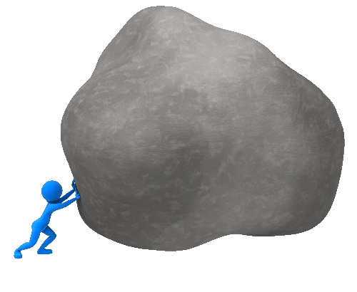






Scrum Master service to the Development Team
Notes:
Suggested reading**
Remove impediments - http://blog.scrum.org/scrum-master-impediment-remover/
Coach - http://blog.scrum.org/the-scrum-master-as-a-coach/
Protect
Guide
Improve
Helps the team deal with conflict and communication
Mentor - http://blog.scrum.org/the-scrum-master-as-a-mentor/
Facilitator - http://blog.scrum.org/the-scrum-master-as-a-facilitator/
Scrum Master Service to the Development Team
The Scrum Master serves the Development Team in several ways, including:
• Coaching the Development Team in self-organization and cross-functionality;
• Helping the Development Team to create high-value products;
• Removing impediments to the Development Team’s progress;
Facilitating Scrum events as requested or needed; and,
• Coaching the Development Team in organizational environments in which Scrum is not yet fully adopted and understood.

Slide 28

Scrum Master service to
the Organisation
Notes:
Suggested reading** https://blog.scrum.org/scrum-master-change-agent/?utm_source=newsletter&utm_medium=email&utm_campaign=blog
Scrum Master Service to the Organization
The Scrum Master serves the organization in several ways, including:
• Leading and coaching the organization in its Scrum adoption;
• Planning Scrum implementations within the organization;
• Helping employees and stakeholders understand and enact Scrum and empirical product development;
• Causing change that increases the productivity of the Scrum Team; and,
• Working with other Scrum Masters to increase the effectiveness of the application of Scrum in the organization.

Slide 29
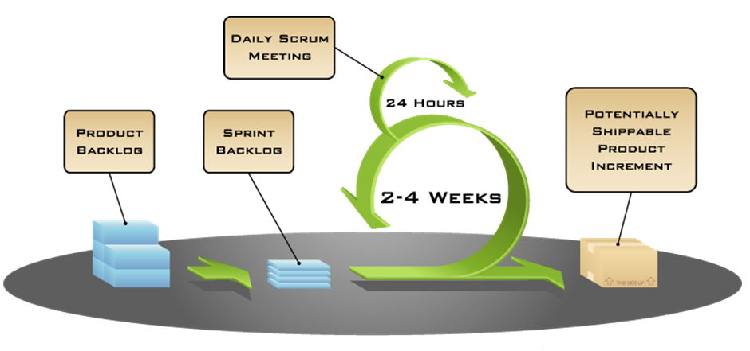
Scrum Process Diagram
TYPICALLY

Slide 30



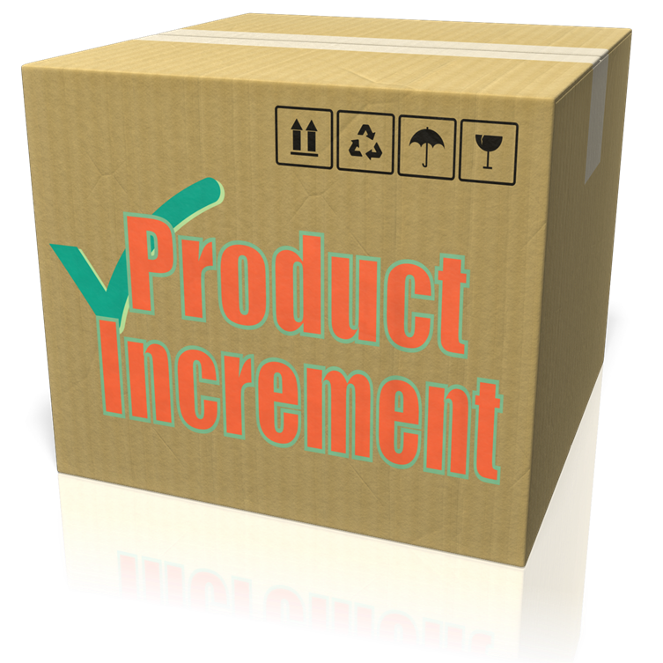


Scrum Process Diagram
Wish List
Sprint 1-4 weeks
Retrospective
Sprint Backlog
Sprint
Review
Daily Scrum
Product Backlog
Notes:
Build slide – high level view of how scrum works

Slide 31

The Sprint
Cancelling
a Sprint
Notes:
The Sprint
The heart of Scrum is a Sprint, a time-box of one month or less during which a “Done”, useable, and potentially releasable product Increment is created. Sprints best have consistent durations throughout a development effort. A new Sprint starts immediately after the conclusion of the previous Sprint.
Sprints contain and consist of the Sprint Planning, Daily Scrums, the development work, the Sprint Review, and the Sprint Retrospective.
During the Sprint:
• No changes are made that would endanger the Sprint Goal;
• Quality goals do not decrease; and,
• Scope may be clarified and re-negotiated between the Product Owner and Development Team as more is learned.
Each Sprint may be considered a project with no more than a one-month horizon. Like projects, Sprints are used to accomplish something. Each Sprint has a definition of what is to be built, a design and flexible plan that will guide building it, the work, and the resultant product.
Sprints are limited to one calendar month. When a Sprint’s horizon is too long the definition of what is being built may change, complexity may rise, and risk may increase. Sprints enable predictability by ensuring inspection and adaptation of progress toward a Sprint Goal at least every calendar month. Sprints also limit risk to one calendar month of cost.
Cancelling a Sprint
A Sprint can be cancelled before the Sprint time-box is over. Only the Product Owner has the authority to cancel the Sprint, although he or she may do so under influence from the stakeholders, the Development Team, or the Scrum Master.
A Sprint would be cancelled if the Sprint Goal becomes obsolete. This might occur if the company changes direction or if market or technology conditions change. In general, a Sprint should be cancelled if it no longer makes sense given the circumstances. But, due to the short duration of Sprints, cancellation rarely makes sense.
When a Sprint is cancelled, any completed and “Done” Product Backlog items are reviewed. If part of the work is potentially releasable, the Product Owner typically accepts it. All incomplete Product Backlog Items are re-estimated and put back on the Product Backlog. The work done on them depreciates quickly and must be frequently re-estimated.
Sprint cancellations consume resources, since everyone has to regroup in another Sprint Planning to start another Sprint. Sprint cancellations are often traumatic to the Scrum Team, and are very uncommon.

Slide 32
Refining the Product Backlog
Notes:
Suggestion** If you are using the lego simulation exercise, get the delegates to help you create a product backlog.
Based on a roadmap of Hamlet – Village – Town – City
Hamlet – group of houses with utilities and connected by a road
Village = Hamlet + shops
Town = Village + Church
City = Town + either University or Cathdral
Discuss how the PO value adjusts and how the team can help with refinement.
Scrum Artifacts
Product Backlog
Product Backlog refinement is the act of adding detail, estimates, and order to items in the Product Backlog. This is an ongoing process in which the Product Owner and the Development Team collaborate on the details of Product Backlog items. During Product Backlog refinement, items are reviewed and revised. The Scrum Team decides how and when refinement is done. Refinement usually consumes no more than 10% of the capacity of the Development Team. However, Product Backlog items can be updated at any time by the Product Owner or at the Product Owner’s discretion.
Higher ordered Product Backlog items are usually clearer and more detailed than lower ordered ones. More precise estimates are made based on the greater clarity and increased detail; the lower the order, the less detail. Product Backlog items that will occupy the Development Team for the upcoming Sprint are refined so that any one item can reasonably be “Done” within the Sprint time-box. Product Backlog items that can be “Done” by the Development Team within one Sprint are deemed “Ready” for selection in a Sprint Planning. Product Backlog items usually acquire this degree of transparency through the above described refining activities.
The Development Team is responsible for all estimates. The Product Owner may influence the Development Team by helping it understand and select trade-offs, but the people who will perform the work make the final estimate.

Slide 33

Sprint Planning
Plan created collaboratively.
Time-boxed to 8 hours for a one month Sprint.
What can be delivered in the Increment resulting from the upcoming Sprint?
How will the work needed to deliver the Increment be achieved?
1
Notes:
Suggestion** If you are using the lego simulation exercise, introduce sprint planning then get the delegates to storypoint the PBI’s they created using planning poker…you may want to get them to t-shirt size, I use planning poker as it’s something a lot of people have never done.
Make sure they are looking at complexity and not trying to estimate time.
I act as a Product Owner during the sprint planning, but I stay quiet until they ask me something…I have found they start to make massive assumptions over detail without asking me.
Then when they get into a debate I stop the exercise and ask what they are doing wrong?
Normally after this they start to involve me in clarifying the details of the PBI’s if they aren’t already clarified.
Sprint Planning
The work to be performed in the Sprint is planned at the Sprint Planning. This plan is created by the collaborative work of the entire Scrum Team.
Sprint Planning is time-boxed to a maximum of eight hours for a one-month Sprint. For shorter Sprints, the event is usually shorter. The Scrum Master ensures that the event takes place and that attendants understand its purpose. The Scrum Master teaches the Scrum Team to keep it within the time-box.
Sprint Planning answers the following:
• What can be delivered in the Increment resulting from the upcoming Sprint?
• How will the work needed to deliver the Increment be achieved?
Topic One: What can be done this Sprint?
The Development Team works to forecast the functionality that will be developed during the Sprint. The Product Owner discusses the objective that the Sprint should achieve and the Product Backlog items that, if completed in the Sprint, would achieve the Sprint Goal. The entire Scrum Team collaborates on understanding the work of the Sprint.
The input to this meeting is the Product Backlog, the latest product Increment, projected capacity of the Development Team during the Sprint, and past performance of the Development Team. The number of items selected from the Product Backlog for the Sprint is solely up to the Development Team. Only the Development Team can assess what it can accomplish over the upcoming Sprint.
After the Development Team forecasts the Product Backlog items it will deliver in the Sprint, the Scrum Team crafts a Sprint Goal. The Sprint Goal is an objective that will be met within the Sprint through the implementation of the Product Backlog, and it provides guidance to the Development Team on why it is building the Increment.

Slide 34
The
Sprint
Backlog
Notes:
Suggestion** Discuss how the team agree the work.
How do their teams do this?
Are they directed?
Do they think their PO would try and get the team to over promise?
What are the problems with this type of behaviour?
What should their interactions as a SM be in this meeting?
If you are using the Lego Simulation, be a nice PO to start with, don’t try and get them to overcommit.
Artifact Sprint Backlog
The Sprint Backlog is the set of Product Backlog items selected for the Sprint, plus a plan for delivering the product Increment and realizing the Sprint Goal. The Sprint Backlog is a forecast by the Development Team about what functionality will be in the next Increment and the work needed to deliver that functionality into a “Done” Increment.
The Sprint Backlog makes visible all of the work that the Development Team identifies as necessary to meet the Sprint Goal.
The Sprint Backlog is a plan with enough detail that changes in progress can be understood in the Daily Scrum. The Development Team modifies the Sprint Backlog throughout the Sprint, and the Sprint Backlog emerges during the Sprint. This emergence occurs as the Development Team works through the plan and learns more about the work needed to achieve the Sprint Goal.
As new work is required, the Development Team adds it to the Sprint Backlog. As work is performed or completed, the estimated remaining work is updated. When elements of the plan are deemed unnecessary, they are removed. Only the Development Team can change its Sprint Backlog during a Sprint. The Sprint Backlog is a highly visible, real-time picture of the work that the Development Team plans to accomplish during the Sprint, and it belongs solely to the Development Team.

Slide 35

Notes:
Suggestion**
Why is it important to define a sprint goal?
Why does the goal need to be visible to all?
Start to introduce the idea of a BVC or teamboard.
Based upon what they have decided to do, get the delegates to create a BVC using the white board or some flipchart paper. Simple column headings TO DO…In progress…Testing…Done
Make sure it is accessible if you are carrying our a sprint exercise like the lego simulation so they can update it as they go.
Get the delegates to add the Product Vision…get them to add the sprint goal.
Do the teams have any rules they might add to the sprint board?
Sprint Goal: a short expression of the purpose of a Sprint, often a business problem that is addressed. Functionality might be adjusted during the Sprint in order to achieve the Sprint Goal.
Source: https://www.scrum.org/Resources/Scrum-Glossary

Slide 36

Sprint Planning
Work planned for the first days of the Sprint by the Development Team is decomposed by the end of this meeting.
The Product Owner can help to clarify the selected Product Backlog items and make trade-offs.
The Development Team should be able to explain how it intends to work as a self-organizing team to accomplish the Sprint Goal and create the anticipated Increment.
1
Notes:
Suggestion**
If carrying out an exercise like the lego simulation, get the delegates to start organise the work, watch out for people starting to direct others, look for people not participating.
Who will be testing?
Sprint Planning (also introduce definition of done as part of sprint planning, definition covered later)
Topic Two: How will the chosen work get done?
Having set the Sprint Goal and selected the Product Backlog items for the Sprint, the Development Team decides how it will build this functionality into a “Done” product Increment during the Sprint. The Product Backlog items selected for this Sprint plus the plan for delivering them is called the Sprint Backlog.
The Development Team usually starts by designing the system and the work needed to convert the Product Backlog into a working product Increment. Work may be of varying size, or estimated effort. However, enough work is planned during Sprint Planning for the Development Team to forecast what it believes it can do in the upcoming Sprint. Work planned for the first days of the Sprint by the Development Team is decomposed by the end of this meeting, often to units of one day or less. The Development Team self-organizes to undertake the work in the Sprint Backlog, both during Sprint Planning and as needed throughout the Sprint.
The Product Owner can help to clarify the selected Product Backlog items and make trade-offs. If the Development Team determines it has too much or too little work, it may renegotiate the selected Product Backlog items with the Product Owner. The Development Team may also invite other people to attend in order to provide technical or domain advice.
By the end of the Sprint Planning, the Development Team should be able to explain to the Product Owner and Scrum Master how it intends to work as a self-organizing team to accomplish the Sprint Goal and create the anticipated Increment.
Definition of “Done”
When a Product Backlog item or an Increment is described as “Done”, everyone must understand what “Done” means. Although this varies significantly per Scrum Team, members must have a shared understanding of what it means for work to be complete, to ensure transparency. This is the definition of “Done” for the Scrum Team and is used to assess when work is complete on the product Increment.
The same definition guides the Development Team in knowing how many Product Backlog items it can select during a Sprint Planning. The purpose of each Sprint is to deliver Increments of potentially releasable functionality that adhere to the Scrum Team’s current definition of “Done.”
Development Teams deliver an Increment of product functionality every Sprint. This Increment is useable, so a Product Owner may choose to immediately release it. If the definition of "done" for an increment is part of the conventions, standards or guidelines of the development organization, all Scrum Teams must follow it as a minimum. If "done" for an increment is not a convention of the development organization, the Development Team of the Scrum Team must define a definition of “done” appropriate for the product. If there are multiple Scrum Teams working on the system or product release, the development teams on all of the Scrum Teams must mutually define the definition of “Done.”
Each Increment is additive to all prior Increments and thoroughly tested, ensuring that all Increments work together.
As Scrum Teams mature, it is expected that their definitions of “Done” will expand to include more stringent criteria for higher quality. Any one product or system should have a definition of “Done” that is a standard for any work done on it.

Slide 37


1
The development work
Requirements are developed and tested as part of the development work.
Individuals sign up for work of their own choosing.
Work is never assigned.
Estimated work remaining is updated daily.
2

Slide 38








Sprint
Goal
To do
In
Progress
Testing
Done
Monitoring Sprint Progress
Notes:
Monitoring Sprint Progress (Daily Scrum covered next) start the discussion on information radiators.
At any point in time in a Sprint, the total work remaining in the Sprint Backlog can be summed. The Development Team tracks this total work remaining at least for every Daily Scrum to project the likelihood of achieving the Sprint Goal. By tracking the remaining work throughout the Sprint, the Development Team can manage its progress.
Definition of “Done”
When a Product Backlog item or an Increment is described as “Done”, everyone must understand what “Done” means. Although this varies significantly per Scrum Team, members must have a shared understanding of what it means for work to be complete, to ensure transparency. This is the definition of “Done” for the Scrum Team and is used to assess when work is complete on the product Increment.
Velocity: an optional, but often used, indication of the average amount of Product Backlog turned into an Increment of product during a Sprint by a Scrum Team, tracked by the Development Team for use within the Scrum Team.

Slide 39

The Daily Scrum
Question 1
Question 2
What did I do yesterday that helped the Development Team meet the Sprint Goal?
2
What will I do today to help the Development Team meet the Sprint Goal?
1
Question 3
Do I see any impediment that prevents me or the Development Team from meeting the Sprint Goal?
3
Notes:
Daily Scrum (burn down charts covered next) …cover distributed teams
The Daily Scrum is a 15-minute time-boxed event for the Development Team to synchronize activities and create a plan for the next 24 hours. This is done by inspecting the work since the last Daily Scrum and forecasting the work that could be done before the next one. The Daily Scrum is held at the same time and place each day to reduce complexity. During the meeting, the Development Team members explain:
• What did I do yesterday that helped the Development Team meet the Sprint Goal?
• What will I do today to help the Development Team meet the Sprint Goal?
• Do I see any impediment that prevents me or the Development Team from meeting the Sprint Goal?
The Development Team uses the Daily Scrum to inspect progress toward the Sprint Goal and to inspect how progress is trending toward completing the work in the Sprint Backlog. The Daily Scrum optimizes the probability that the Development Team will meet the Sprint Goal. Every day, the Development Team should understand how it intends to work together as a self-organizing team to accomplish the Sprint Goal and create the anticipated Increment by the end of the Sprint. The Development Team or team members often meet immediately after the Daily Scrum for detailed discussions, or to adapt, or replan, the rest of the Sprint’s work.
The Scrum Master ensures that the Development Team has the meeting, but the Development Team is responsible for conducting the Daily Scrum. The Scrum Master teaches the Development Team to keep the Daily Scrum within the 15-minute time-box.
The Scrum Master enforces the rule that only Development Team members participate in the Daily Scrum.
Daily Scrums improve communications, eliminate other meetings, identify impediments to development for removal, highlight and promote quick decision-making, and improve the Development Team’s level of knowledge. This is a key inspect and adapt meeting.

Slide 40


Burn-down Chart
Notes:
Burn-down Chart: a chart showing the evolution of remaining effort against time. Burn-down charts are an optional implementation within Scrum to make progress transparent.
Burn-up Chart: a chart showing the evolution of an increase in a measure against time. Burn-up charts are an optional implementation within Scrum to make progress transparent.

Slide 41
1
The development work
Nobody is allowed to tell the Development Team to work from a different set of requirements.
The team should be protected from outside noise.
Any Team member can add to, delete from or change the Sprint Backlog.
2

Slide 42
1
Sprint Review
3
Four-hour time-boxed meeting for one-month Sprints.
Attendees include the Scrum Team and key stakeholders invited by the Product Owner.
The Product Owner explains what Product Backlog items have been “Done” and what has not been “Done”.
The Development Team demonstrates the work that it has “Done” and answers questions about the Increment.
Notes:
Sprint Review
A Sprint Review is held at the end of the Sprint to inspect the Increment and adapt the Product Backlog if needed. During the Sprint Review, the Scrum Team and stakeholders collaborate about what was done in the Sprint. Based on that and any changes to the Product Backlog during the Sprint, attendees collaborate on the next things that could be done to optimize value. This is an informal meeting, not a status meeting, and the presentation of the Increment is intended to elicit feedback and foster collaboration.
This is a four-hour time-boxed meeting for one-month Sprints. For shorter Sprints, the event is usually shorter. The Scrum Master ensures that the event takes place and that attendants understand its purpose. The Scrum Master teaches all to keep it within the time-box.
The Sprint Review includes the following elements:
• Attendees include the Scrum Team and key stakeholders invited by the Product Owner;
• The Product Owner explains what Product Backlog items have been “Done” and what has not been “Done”;
• The Development Team discusses what went well during the Sprint, what problems it ran into, and how those problems were solved;
• The Development Team demonstrates the work that it has “Done” and answers questions about the Increment;
• The Product Owner discusses the Product Backlog as it stands. He or she projects likely completion dates based on progress to date (if needed);
• The entire group collaborates on what to do next, so that the Sprint Review provides valuable input to subsequent Sprint Planning;
• Review of how the marketplace or potential use of the product might have changed what is the most valuable thing to do next; and,
• Review of the timeline, budget, potential capabilities, and marketplace for the next anticipated release of the product.
The result of the Sprint Review is a revised Product Backlog that defines the probable Product Backlog items for the next Sprint. The Product Backlog may also be adjusted overall to meet new opportunities.
Definition of “Done”
When a Product Backlog item or an Increment is described as “Done”, everyone must understand what “Done” means. Although this varies significantly per Scrum Team, members must have a shared understanding of what it means for work to be complete, to ensure transparency. This is the definition of “Done” for the Scrum Team and is used to assess when work is complete on the product Increment.
The same definition guides the Development Team in knowing how many Product Backlog items it can select during a Sprint Planning. The purpose of each Sprint is to deliver Increments of potentially releasable functionality that adhere to the Scrum Team’s current definition of “Done.”
Development Teams deliver an Increment of product functionality every Sprint. This Increment is useable, so a Product Owner may choose to immediately release it. If the definition of "done" for an increment is part of the conventions, standards or guidelines of the development organization, all Scrum Teams must follow it as a minimum. If "done" for an increment is not a convention of the development organization, the Development Team of the Scrum Team must define a definition of “done” appropriate for the product. If there are multiple Scrum Teams working on the system or product release, the development teams on all of the Scrum Teams must mutually define the definition of “Done.”
Each Increment is additive to all prior Increments and thoroughly tested, ensuring that all Increments work together.
As Scrum Teams mature, it is expected that their definitions of “Done” will expand to include more stringent criteria for higher quality. Any one product or system should have a definition of “Done” that is a standard for any work done on it.

Slide 43
Sprint Retrospective
Three-hour time-boxed meeting for one-month Sprint.
Inspect how the last Sprint went with regards to people, relationships, process, and tools.
Identify and order the major items that went well and potential improvements.
Start/Stop/Continue.
4
1
3
2
Notes:
Sprint Retrospective
The Sprint Retrospective is an opportunity for the Scrum Team to inspect itself and create a plan for improvements to be enacted during the next Sprint.
The Sprint Retrospective occurs after the Sprint Review and prior to the next Sprint Planning. This is a three-hour time-boxed meeting for one-month Sprints. For shorter Sprints, the event is usually shorter. The Scrum Master ensures that the event takes place and that attendants understand its purpose. The Scrum Master teaches all to keep it within the time-box. The Scrum Master participates as a peer team member in the meeting from the accountability over the Scrum process.
The purpose of the Sprint Retrospective is to:
• Inspect how the last Sprint went with regards to people, relationships, process, and tools;
• Identify and order the major items that went well and potential improvements; and,
• Create a plan for implementing improvements to the way the Scrum Team does its work.
The Scrum Master encourages the Scrum Team to improve, within the Scrum process framework, its development process and practices to make it more effective and enjoyable for the next Sprint. During each Sprint Retrospective, the Scrum Team plans ways to increase product quality by adapting the definition of “Done” as appropriate.
By the end of the Sprint Retrospective, the Scrum Team should have identified improvements that it will implement in the next Sprint. Implementing these improvements in the next Sprint is the adaptation to the inspection of the Scrum Team itself. Although improvements may be implemented at any time, the Sprint Retrospective provides a formal opportunity to focus on inspection and adaptation.

Slide 44
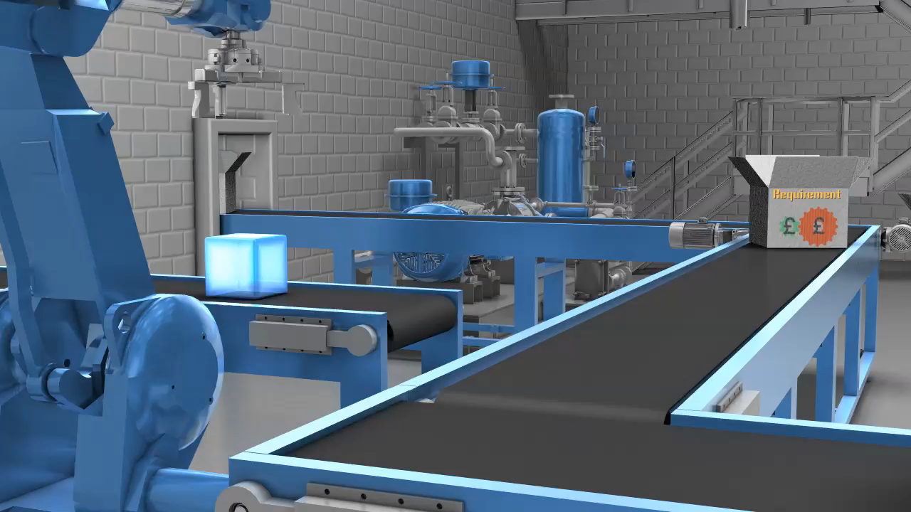
Potentially shippable product

Slide 45
Sprint Retrospective
4
1
Sprint Planning
Sprint Review
3
2
The development work
Notes:
Increment (discuss the same cycle to deliver product increments)
Increment
The Increment is the sum of all the Product Backlog items completed during a Sprint and the value of the increments of all previous Sprints. At the end of a Sprint, the new Increment must be “Done,” which means it must be in useable condition and meet the Scrum Team’s definition of “Done.” It must be in useable condition regardless of whether the Product Owner decides to actually release it.
Development Teams deliver an Increment of product functionality every Sprint. This Increment is useable, so a Product Owner may choose to immediately release it. If the definition of "done" for an increment is part of the conventions, standards or guidelines of the development organization, all Scrum Teams must follow it as a minimum. If "done" for an increment is not a convention of the development organization, the Development Team of the Scrum Team must define a definition of “done” appropriate for the product. If there are multiple Scrum Teams working on the system or product release, the development teams on all of the Scrum Teams must mutually define the definition of “Done.”
Each Increment is additive to all prior Increments and thoroughly tested, ensuring that all Increments work together.

Slide 46
Scrum on a page
Sprint Planning
Sprint Review
Sprint Retrospective
Product Increment
Work & Daily Scrum
Artefacts
Product Backlog
Sprint Backlog
Product Increment
Roles
Product Owner
Scrum Master
Developer

